Slide 1
Chapter 10: Team Building and Teamwork
Presenters:
1. Samuel Torimiro
2. Mohammed Sailal Shaik
3. Vishnu Teja Ramisetty
4. Karolina Noszczyk
5. Efosa Ojomo

Slide 2
Overview of Team Building and Teamwork
Teamwork is a fundamental element of total quality.
The reason for this is simple and practical. It is organizations, not individuals, that produce products and provide services.
Consequently, peak performance and continual improvement are group, not individual, endeavors.

Slide 3
What is a Team?
A team is a group of people with a common, collective goal.
The collective goal aspect of teams is critical.
A team’s ability is more than just the sum of the abilities of the individual members.

Slide 4
Rationale for Teams
Teams satisfy the human social need to belong.
Two or more heads are better than one.
The whole (the team) can be greater than the sum of its parts (individual members).
People in teams get to know each other, build trust, and, as a result, want to help each other.
Teamwork promotes better communication.
Teamwork multiplies the potential of individual members.
Teamwork produces positive peer pressure.
We should note that it is well established that teams can outperform individuals, provided they are properly handled.
Also, a team is not just a group of people.

Slide 5
A group of people becomes a team when the following conditions exist:
Agreement exists as to the team’s mission.
Members adhere to team ground rules.
Fair distribution of responsibilities and authority exists.
People adapt to change. People in teams should help each other adapt to change in a positive way.

Slide 6
Learning to Work Together
A group of people does not make a team.
People in a group do not automatically or magically find ways to work together.
One of the reasons teams don’t always work as well as they might is certain built-in human factors that, unless understood and dealt with, can undermine success.
These factors include:
  Identity within the organizations
  Personal identity of team members
  Relationships among team members

Slide 7
Team Excellence & Performance
Teamwork is not a magic cure-all. Poorly run teams can do more damage to an organization’s performance and corresponding competitiveness than having no teams at all.
In order to ensure excellence in teamwork, team leaders should attempt to develop the following characteristics of effective teams:
  People skills
  Singleness of purpose
  Accountability
  Reinforcement
  Challenges
Trust
Participation
  Mutual support

Slide 8

Building Teams and Making them Work
Some work teams are permanent (departments, sections, divisions, etc.). However, some are ad hoc – they are formed to complete a specific assignment or mission.
Part of building a successful team is choosing team members wisely.

Slide 9
Makeup and size of teams
Teams should be composed of those people who are most likely to be able to satisfy the team’s mission efficiently and effectively.
The membership of such teams should be open to any level of employee – management, supervisors, and hourly wage earners.
Note that, a good rule of thumb is that the greater the mix, the better.

Slide 10
Choosing team members
When putting together a team, the first step is to identify all potential team members.
This is important because there will often be more potential team members than the number of members actually needed (maximum of 12 members).
After the list has been compiled, volunteers can be solicited and actual team members selected from among those who volunteer.
However, care should be taken to ensure a broad mix. This rule should be adhered to even if there are no volunteers and team members must be drafted.
The more likely care is that there will be more volunteers than openings on most teams.

Slide 11
Responsibilities of team leaders
Most teams will have members who are managers, supervisors, and hourly employees.
However, it should not be assumed that the highest-level manager will automatically be the team leader.
Correspondingly, it should not necessarily be assumed that the most junior hourly worker cannot be the team leader, at least in the case of ad hoc teams.
The first step in selecting a team leader is to develop an understanding of the role and responsibilities of this individual.

Slide 12
Team leaders perform the following functions:
Serve as the official contact between the team and the rest of the organization.
Serve as the official record keeper for the team. Records include minutes, correspondence, agendas, and reports. Typically, the team leader will appoint a recorder to take minutes during meetings. However, the team leader is still responsible for redistributing and filling minutes.
Serve as a full-fledged team member but exercise care to avoid dominating team discussions.
Implement team recommendations that fall within the team leader’s realm of authority and work with upper management to implement those that fall outside it.
Motivate, monitor, and mentor other team members.

Slide 13

Other team members
In addition to the team leader, most teams will need a team recorder and a quality advisor.
The recorder is responsible for taking minutes during team meetings and assisting the team leader with the various other types of correspondence generated by the team.
The quality advisor is an important part of the team in a total quality environment.

Slide 14
Creating the team’s charter
The charter explains the team’s reason for being and its operating ground rules.
The two components of a team charter are the mission and the ground rule.

Slide 15

Developing mutually supportive peer relationships
A team works most effectively when individual team members form positive, mutually supportive peer relationships.

Slide 16
Promoting diversity in teams
In modern workplace, diverse employees, properly managed and trained, can make high-performance, world-class teams.

Slide 17

Four-Step Approach to Team Building
Assess
Plan
Execute
Evaluate

Slide 18

Assessing Team Needs
Emphasize the importance of assessing the team's developmental needs.
the need for a clear mission, goals, and accountability measures.
Introduce the team-building needs assessment tool

Slide 19


Slide 20
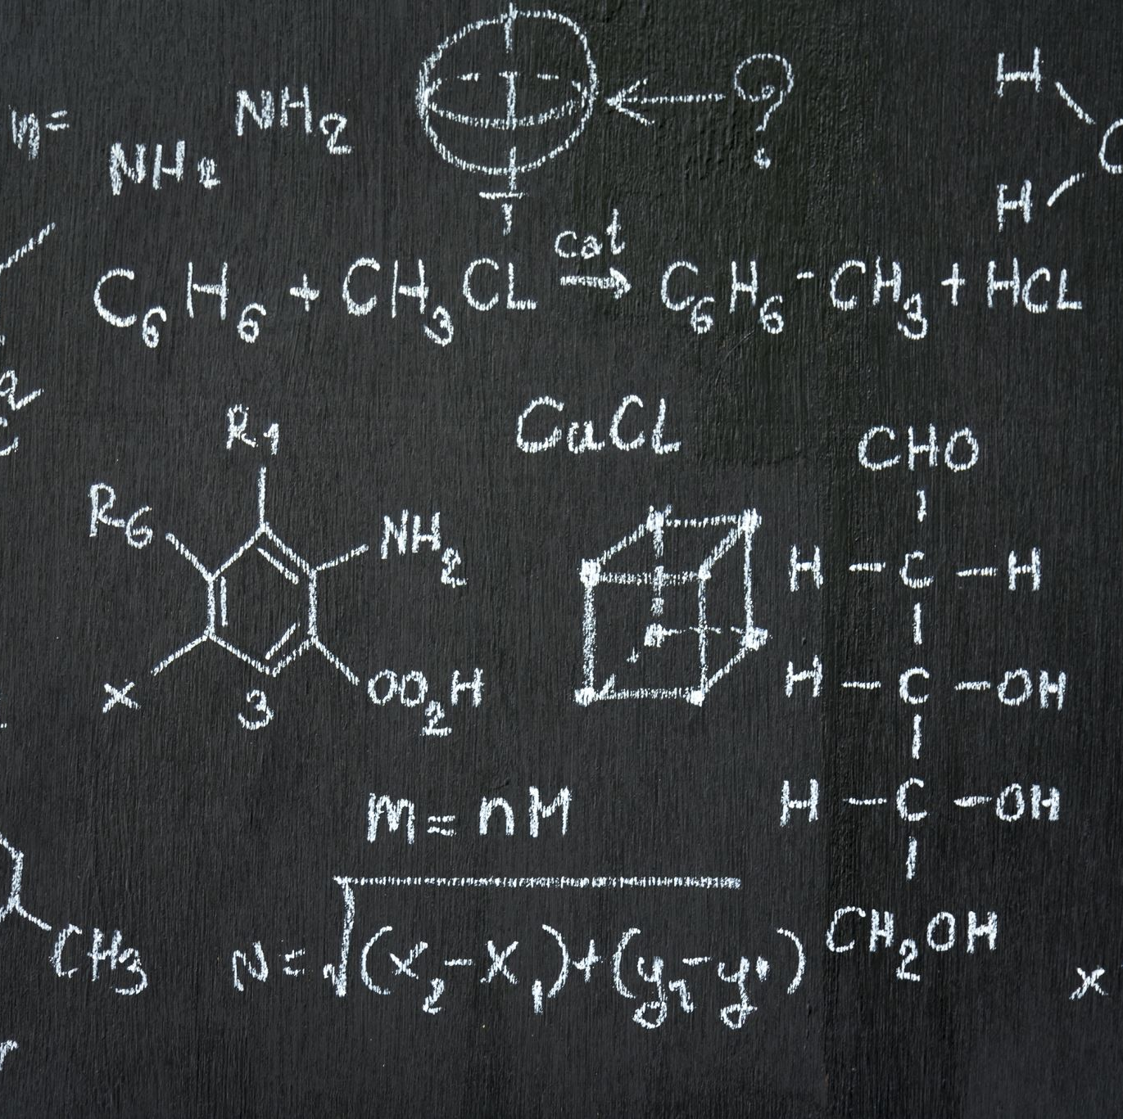
Team Assignment
Completely True (CT) = 6 , Somewhat True (ST)= 4, Somewhat False (SF)= 2, Completely False (CF)= 0
Team member 1= 4
Team member 2=2
Team member 3=2
Team member 4=4
12
12 / 4 = 3 (team average score)

Slide 21
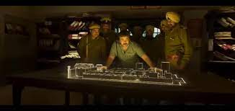
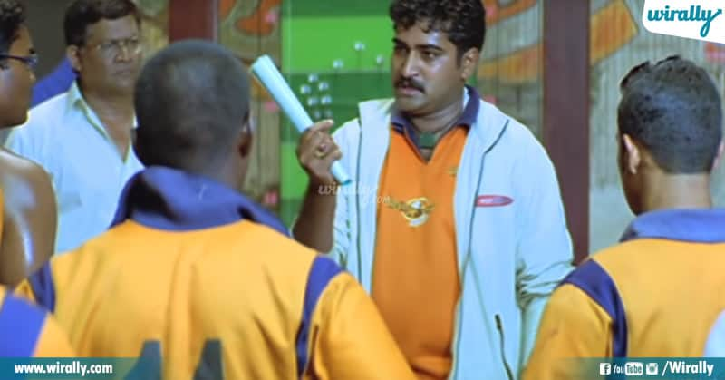
Planning Team-Building Activities
Plan Team Building activities based on the assessment.
Use an example to illustrate how lower assessment scores indicate areas in need of improvement.

Slide 22
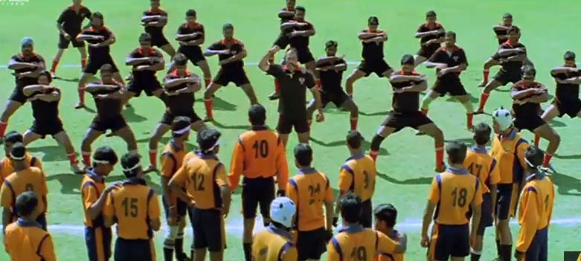
Executing Team Building Activities
Read ministering Needs Assessment
Focusing on Specific Targeted Areas
Adjusting Activities Based on Evaluation Results

Slide 23
Evaluating Team-Building Activities
Emphasize the importance of assessing the impact of team-building initiatives.
Highlight the need for a structured evaluation process to measure progress.
Introduce the "Team-Building Needs Assessment" tool as a guide for assessing the effectiveness of activities.
Show a sample before-and-after comparison of team assessment scores to demonstrate improvement.

Slide 24

Character Traits and
Teamwork

Slide 25
Character Traits and
Teamwork
Honesty/Integrity
Selflessness
Dependability
Tolerance/Sensitivity
Perseverance
Enthusiasm
Responsibility
Cooperativeness
Initiative
Patience
Resourcefulness
Punctuality

Slide 26

Teams are Coached – Not Bossed
Working together as a team means helping and guiding each other instead of just giving orders.
Good leaders support their team member’s growth, encourage everyone to be respectful, and appreciate differences. By doing this, everyone can perform at their best all the time.

Slide 27

Team Development and Team Building
Team leaders should help everyone develop their skills and encourage teamwork all the time. This constant effort helps the team work well together and be successful.
Mentoring
Just like sports teams practice a lot to improve individual and team skills, work teams should also focus on getting better together.

Slide 28
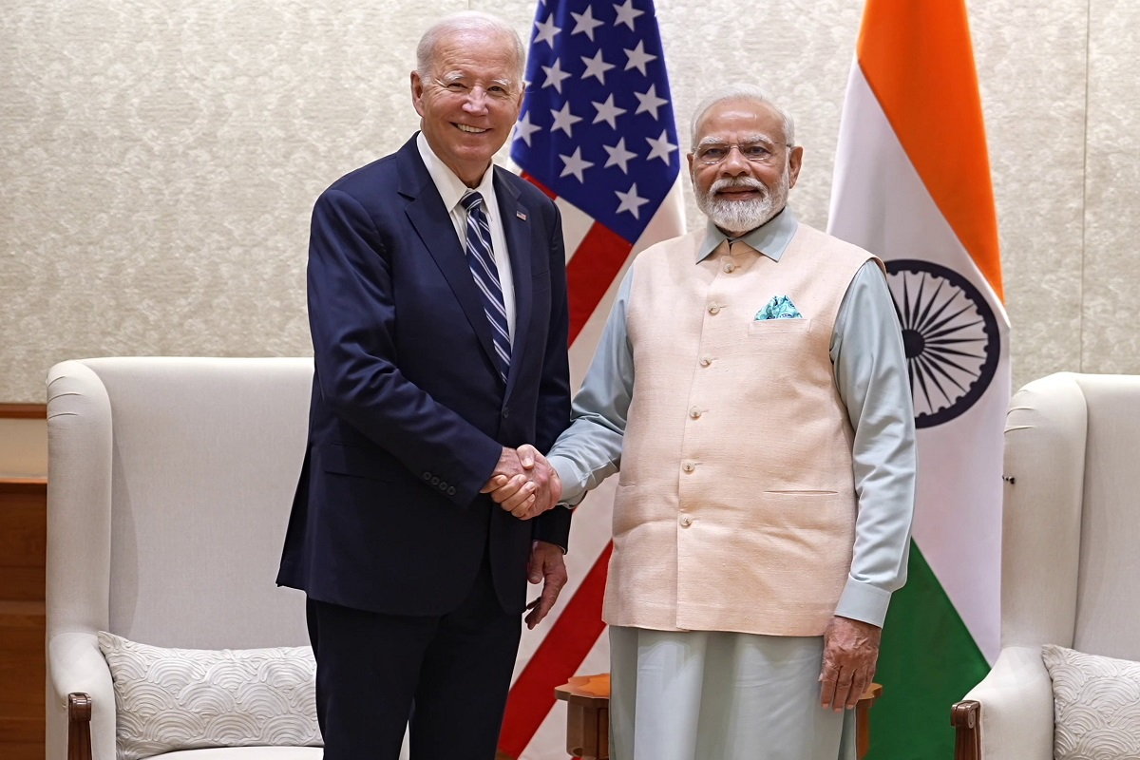

Mutual Respect
It's really important for team members and their coach to respect each other.
This respect comes from understanding and being professional, and it's more important than simply liking each other.
When everyone on the team treats each other with respect, the team can work together better and achieve more.
Trust made tangible.
Appreciation of people as assets.
Communication that is clear and candid.
Ethics that are unequivocal.
Team members are assets.

Slide 29


Human Diversity
Embracing diversity in the workplace is a great thing. It means accepting and appreciating differences among people, like their backgrounds, cultures, and experiences. Even though we've made progress, sometimes there are obstacles that can make it hard for people to work well together.
To keep this from happening, coaches can do the following:
  Conduct a cultural audit.
  Identify the specific needs of different groups.
  Confront cultural clashes.
  Eliminate institutionalized bias.

Slide 30
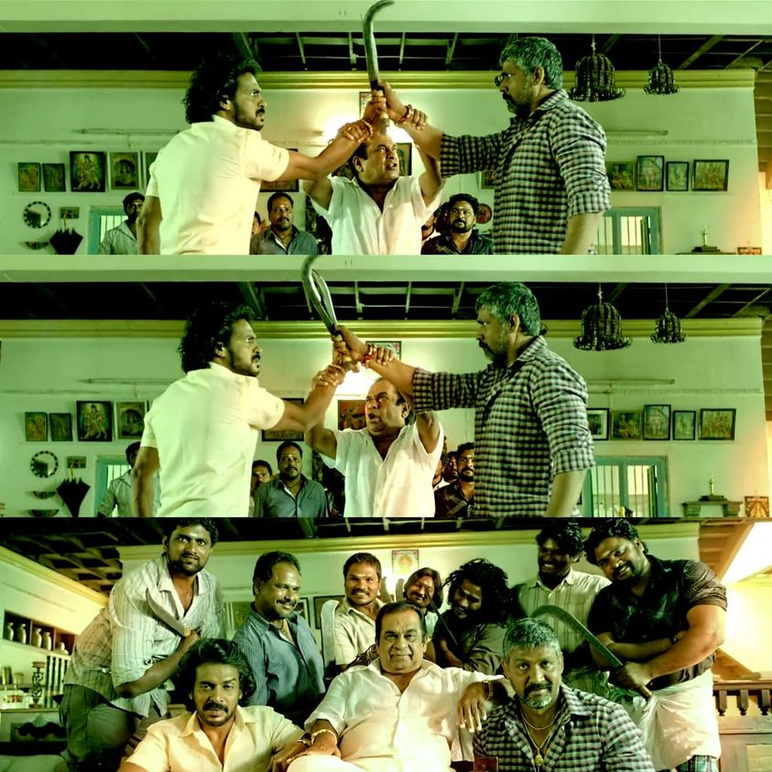
Handling Conflicts in Teams
Team leaders play a crucial role in helping team members solve problems and disagreements in a positive way.
All the possible responses to conflict can be placed in one of the following categories:
  Personally Negative Responses
  Team Negative Responses
  Positive Responses

Slide 31

Resolution Strategies for Team Conflicts
1
Talk and Listen
Encourage open communication.
Share concerns honestly.
Work Together
2
Brainstorm solutions together.
Prioritize team goals.
Work towards the best solution for everyone.
.
3
Learn and Improve
See conflicts as chances to learn.
Analyze after resolving.
Apply lessons to strengthen collaboration.

Slide 32

Structural Inhibitors of Teamwork
A structural inhibitor is an administrative procedure, organizational principle, or cultural element that works against given change. In other words, it is an obstacle within the team that stops effectiveness and growth within the work team.

Slide 33

Example of Structural Inhibitors
An university decided to add distance learning opportunity to one of the classes that previously was only held in person, on campus. The amount of enrolled students in this class tripled. The leading professor has not received any extra pay for a significant increase in amount of students in their class. The professor has no say in setting maximum enrolment limits. The final structural inhibitor was no compensation for developing the course that would benefit such a large amount of students.
In many cases, the university faculty would turn their back on this offer of leading such course. Once those inhibitors were removed, the course took off.

Slide 34

Structural Inhibitors to effective teamwork
Unit structure
Accountability
Unit goals
Responsibility
Compensation and Recognition
Planning and Control

Slide 35

What Makes the Team fail?
Lack of Goals
Poor Communication
Power Dynamics
Inadequate Resources
Geographical Separation
Work Overload
Lack of Diversity
Insufficient Leadership
Unclear Rewards

Slide 36
Rewarding Team and Individual Performance
If you want teamwork to work – make it pay
Even in companies where employees work in teams, it is important to recognize their individual work. The best way to compensate an employee is to
Base Individual Compensation
Individual Incentive Compensation
Team-Based Incentive Compensation
Incentive Compensation – extra money, rewards of value (i.e. stock), based on employee’s performance

Slide 37
Nonmonetary rewards
Get to know your employees (different people respond differently to rewards)
Movie or game tickets, time off, gift certificate, gateways weekends, airline tickets or electronics.
Before investing in nonmonetary rewards, the company should survey their employees (for some, monetary reward will be always more valuable based on their circumstances)
Words of appreciation, thank you cards and being present and close with the employees

Slide 38
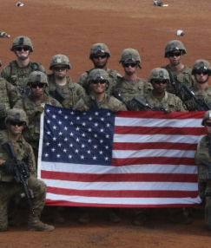
RECOGNIZING TEAMWORK AND TEAM PLAYERS
One of the strongest human motivators is recognition.
Example is the military, when they give medals and decorations to brave soldiers for their outstanding performance

Slide 39
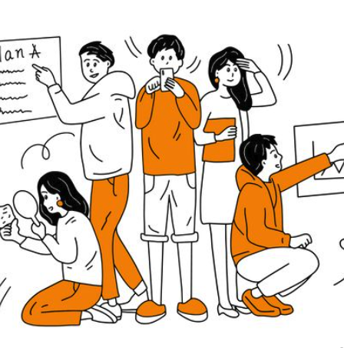
There are different recognisation startegies:
- Write a letter to the employee’s family members telling them about the excellent job the employee is doing.
- Arrange for a senior-level manager to have lunch with the employee.
- Have the CEO of the organization call the employee personally (or stop by in person) to say, “Thanks for a job well done.”
- Find out what the employee’s hobby is and publicly award him or her a gift relating to that hobby.
- Designate the best parking space in the lot for the “Employee of the Month.”
- Create a “Wall of Fame” to honor outstanding performance.

Slide 40

LEADING MULTICULTURAL TEAMS
Most industrialized countries are becoming more and more diverse in terms of their populations, but few can equal the level of diversity in the United States.
Using USA as an example:
This means that work teams in American organizations are increasingly diverse. Leading multicultural work teams can pose several special challenges for managers, supervisors, and team leaders
Culture-related challenges that often arise in work teams include differing
Approaches to communicating,
Attitudes toward work
Attitudes toward authority
Approaches to decision making.
For example, people from Western countries and particularly the United States tend to be direct and to the point when communicating ideas, recommendations, and opinions. People from Asian countries tend to be less so.

Slide 41

STRATEGIES FOR LEADING MULTICULTURAL TEAMS
Leaders or people that leads multicultural team, should ensure they mitigate the problems that may arise
From the cultural differences amongst team members.
Below are some key steps to help mitigate such occurrence:
  Adaptation: With this strategy, team members and leaders commit to adapting their attitudes and practices to
  accommodate cultural differences.
  Structural intervention: With this strategy, team members are reassigned or the team is reorganized to
  reduce problems growing out of interpersonal friction between and among team members or to remove a
  source of conflict
  Managerial guidance: With this strategy, higher management establishes ground rules—ideally before
  the team is constituted. Such as mission and Vision statements
  Exit: With this strategy, team members who are unhappy on the team and cannot be mollified by any of the
  other strategies are allowed to simply leave.

Slide 42

SUMMARY
A team is a group of people with a common, collective goal. The rationale for the team approach to work is that “two heads are better than one.” A group of people becomes a team when the following conditions exist:
That there is agreement as to the mission, members adhere to ground rules, there is a fair distribution of responsibility and authority, and people adapt to change
Thank you

Slide 43
A team well structured and organized will outperform individuals.
A. True
B. False

Slide 44
Team building activities are only effective if they are elaborate and involve significant time and resources.
A. True
B. False

Slide 45
What is the first step in the four-step approach to effective team building?.
A. Execute
B. Assess
C. Plan
D. Evaluate

