Slide 1
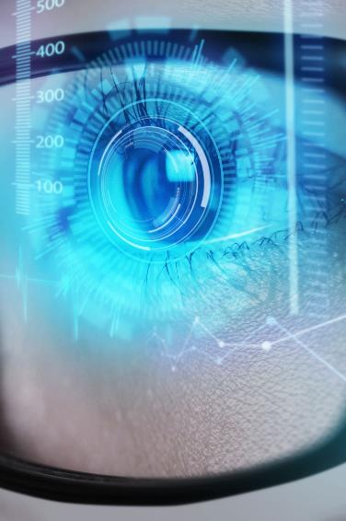
Impact of AI on the Educational System in the United States
Presenters:
Samuel Torimiro
Akomea George
Baassou Hamida

Slide 2
Introduction
Chu et al., (2022), noted that for the last five consecutive years, artificial intelligence (AI) has risen, with the ardent of new AI tools.

Slide 3
“Artificial Intelligence (AI) is a rapidly growing field that encompasses various disciplines, including mathematics, engineering, computer science, philosophy, and linguistics. It has significantly impacted various sectors, including education, by addressing issues such as content accessibility and teacher deficiency.”
(Okello, 2023)

Slide 4
“AI implementation and adoption are inevitable in the education sector, and it includes technologies such as smart learning, tutoring systems, social robots, virtual facilitators, online learning environments, learning management systems, and learning analytics
(Okello, 2023)
Notes:
In most fields, including higher education AI tools are becoming more popular. Although this technology is relatively new and still under development, it showed a lot of future potentials.

Slide 5
“While artificial intelligence is a technology that can be traced back to the first computers, it has brought artificial intelligence-supported (AI) chatbots to its users, which have gained great popularity worldwide with language models called generative artificial intelligence and are growing rapidly.”
(Gökçearslan, et. al, 2024)
Notes:
In most fields, including higher education AI tools are becoming more popular. Although this technology is relatively new and still under development, it showed a lot of future potentials.

Slide 6
“In many fields, AI chatbots continue to be popular with new tools and attract the attention of universities, K12 schools, educational organizations, and researchers.”
(Gökçearslan, et. al, 2024)
Notes:
In most fields, including higher education AI tools are becoming more popular. Although this technology is relatively new and still under development, it showed a lot of future potentials.

Slide 7
The Disadvantages of AI Chatbots in Education
Notes:
In most fields, including higher education AI tools are becoming more popular. Although this technology is relatively new and still under development, it showed a lot of future potentials.

Slide 8
Disadvantages for Students
Limited interaction.
Misleading answers.
Limited personalized feedback.
(Gökçearslan, et. al, 2024)
Notes:
Increased motivation to learn.
By using machine learning algorithms, AI can gather information about each student's performance and preferences and create a customized curriculum for them.
Personalized and adaptive learning environments.
Artificial intelligence can also personalize student learning. By analyzing student performance data, AI-powered tools can determine which students need support to improve their learning experience, and the best ways to help those students.
Instant feedback.
AI tools can also provide quick assistance when the instructor is not available.

Slide 9
Disadvantages for Trainer
Originality.
Plagiarism.
Inability to determine the level of readiness.
(Gökçearslan, et. al, 2024)
Notes:
Increased motivation to learn.
By using machine learning algorithms, AI can gather information about each student's performance and preferences and create a customized curriculum for them.
Personalized and adaptive learning environments.
Artificial intelligence can also personalize student learning. By analyzing student performance data, AI-powered tools can determine which students need support to improve their learning experience, and the best ways to help those students.
Instant feedback.
AI tools can also provide quick assistance when the instructor is not available.

Slide 10
The Advantages of AI Technology
Notes:
In most fields, including higher education AI tools are becoming more popular. Although this technology is relatively new and still under development, it showed a lot of future potentials.

Slide 11
Advantages for Students
Increased motivation to learn.
Personalized and adaptive learning environments.
Instant feedback.
Notes:
Increased motivation to learn.
By using machine learning algorithms, AI can gather information about each student's performance and preferences and create a customized curriculum for them.
Personalized and adaptive learning environments.
Artificial intelligence can also personalize student learning. By analyzing student performance data, AI-powered tools can determine which students need support to improve their learning experience, and the best ways to help those students.
Instant feedback.
AI tools can also provide quick assistance when the instructor is not available.

Slide 12
Advantages for Students
Ease of access and Improved learning performance.
Self-regulated learning.
Active participation.
Notes:
Ease of access and Improved learning performance.
Students utilizing AI-powered platforms can receive real-time, contextually relevant feedback for the work they submit, allowing them to figure out where they need help and to correct mistakes quickly. Instead of having to wait for feedback from instructors.
Self-regulated learning.
AI programs can help individualize learning opportunities for students. For instance, ChatGPT can quickly and easily translate materials to another language, making it easier for students who speak another language to understand assignments.
Active participation.
active learning starts with a small set of labeled data and requests additional data from the user to improve accuracy.

Slide 13
Advantages for Educators
Time Saving.
Workload Reduction.
Providing Training Resources.
Notes:
Time saving
AI tools can help instructors work more efficiently by allowing them to better personalize lessons and focus on learning—which is only possible when students receive lessons that match their comprehension level along with fast, actionable feedback that guides them to improve their understanding in real time.
Workload reduction
AI can help make teaching job easier, from coming up with lesson plans and generating project ideas to creating quizzes. With assistance from artificial intelligence, teachers can gain more time to spend with their students.
Providing training resources
AI enables employees to learn at their convenience and pace. AI-driven chatbots and virtual assistants offer instant support, provide guidance, and ensure continuous learning.

Slide 14

Should students be forced to think and do their tasks independently?
Notes:
In a study conducted at Tianshui University in China, the researchers examined the impact of AI technology on the student’s memory and performance by comparing the intelligence level and memory problems in students who study in interactive environment using AI tools and those who use conventional methods. The study showed that students in the control and experimental groups averaged similar results. Therefore, the researchers found that forcing students to complete tasks with no help from AI tools is not necessary and does not affect the learning abilities and results.

